Slide 1

Party like Thor in the cloud
Serverless how to

Slide 2
This session IS:
A short presentation
A hands on portion – a how to get started with serverless
A session about AWS Serverless, so you will need your own AWS account
This session is NOT:
An all day session (no lock in)
A deep dive into every aspect of serverless
An enterprise architecture review
Budget information
Agenda:
10-10:30: Serverless presentation and overview
10:30 – 11: Break and setup headstart
11:00 – 11:50 : Hands on portion
Session Info
| ©2016 mapp | mapp.com

Slide 3
What is does serverless really mean, in my opinion
Servers
Yes, there are still servers, we just don’t maintain them anymore
Concept
Serverless is a concept, not a specific technology
Small
Serverless is about small pieces of functionality
Complexity
While making things simpler complexity creeps in
Developer centric
The “serverless” term to me identifies with developers
What is this “serverless” stuff
| ©2016 mapp | mapp.com

Slide 4

Serverless or
How a bunch of caddies made me lose my mind servers
Adrian Pomilio
Sr. UI Architect & Platform Architecture Lead
Mapp Digital / www.mapp.com
Twitter / github / linkedIn : adrianpomilio
| ©2016 mapp | mapp.com

Slide 5

The Story
| ©2016 mapp | mapp.com

Slide 6

Requirements are gathered
| ©2016 mapp | mapp.com

Slide 7
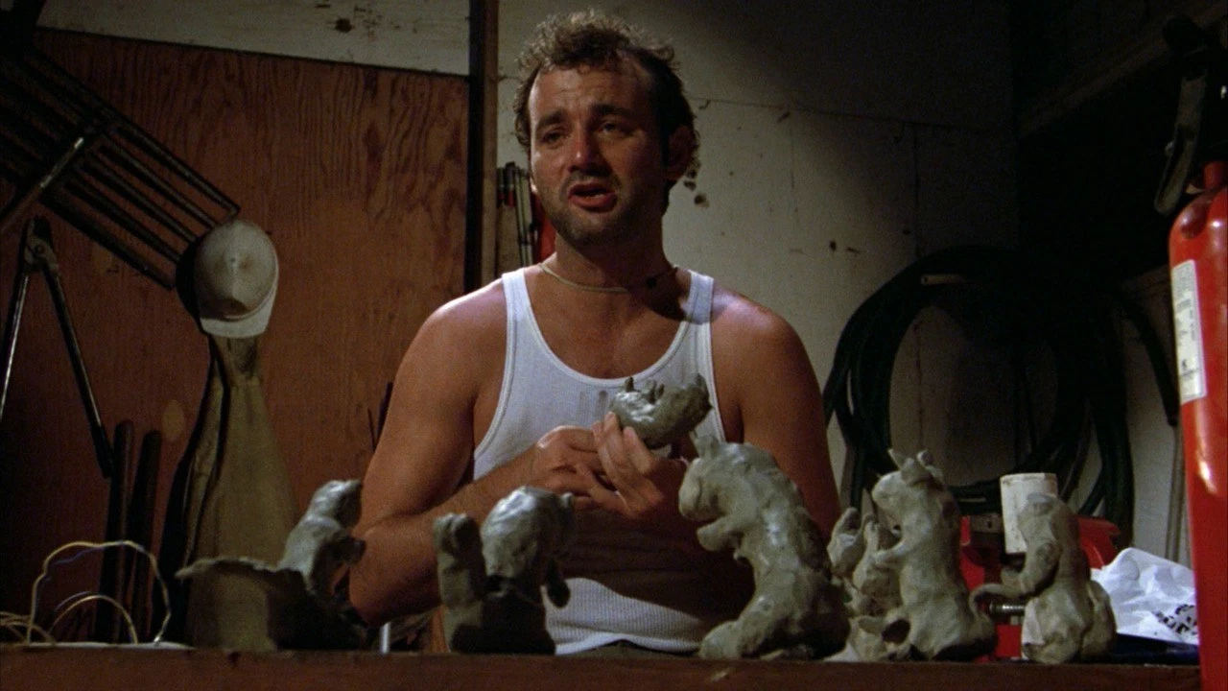
Development
begins
| ©2016 mapp | mapp.com

Slide 8

Setup the infrastructure
| ©2016 mapp | mapp.com

Slide 9

Deploy happens
| ©2016 mapp | mapp.com

Slide 10

I just want to build an app
| ©2016 mapp | mapp.com

Slide 11

Time to gopher what you know
| ©2016 mapp | mapp.com

Slide 12
What is it that we do very well, what are our strengths?
Code
We write code
Design
We design applications
Resources
We work with databases, APIs, file systems and more
What we know
| ©2016 mapp | mapp.com

Slide 13

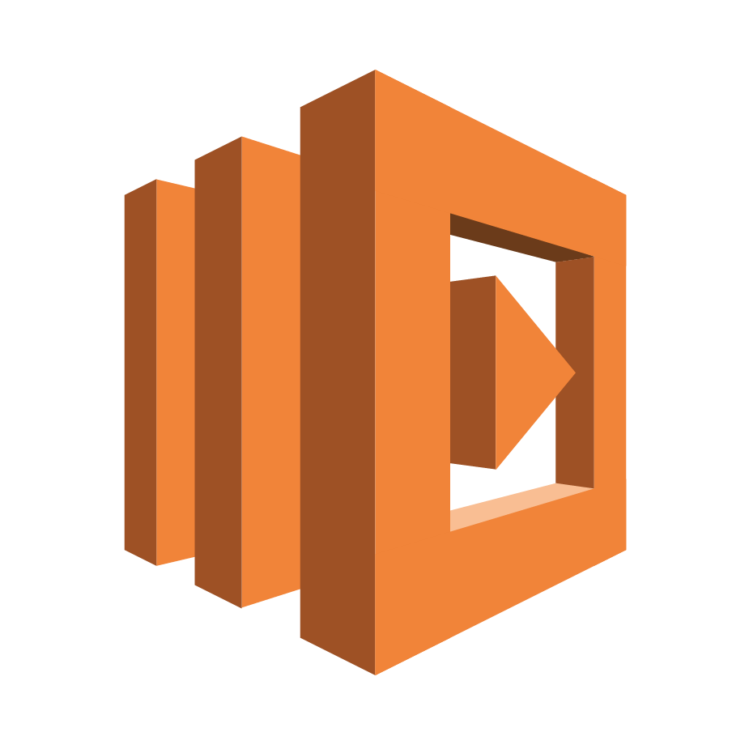


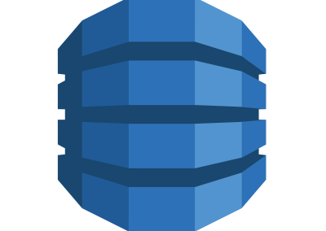
These are the core technologies we will leverage to “go serverless”
Our serverless
environment
API Gateway
Lambda
S3
Cognito
DynamoDB
| ©2016 mapp | mapp.com

Slide 14
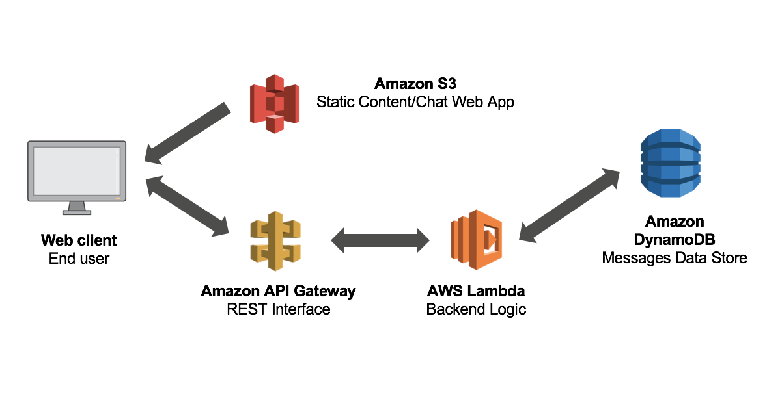
What it all looks like in a picture
Diagram credited to: https://aws.amazon.com/blogs/compute/surviving-the-zombie-apocalypse-with-serverless-microservices/
| ©2016 mapp | mapp.com

Slide 15
AWS API Gateway lets you focus on building your APIs. From easy creation of endpoints to fully managed resources. Plus, you only pay on calls to your API.
Streamline development
AWS allows for multiple APIs and versions at the same time
Scalable
Automatically scales across the network
APIs without servers
AWS manages all the infrastructure
Security, monitoring
Leverage AWS security and monitoring services
API Gateway
| ©2016 mapp | mapp.com

Slide 16
Run your code, don’t worry about servers. No more provisioning or managing these resources. You only pay when the code runs.
Containers
Ready to go containers for many languages
Scaling
Automatically scales when your code is invoked/triggered
Metered
You only pay for compute time. Codes not running, you don’t pay.
Lambda
| ©2016 mapp | mapp.com

Slide 17
How does Lambda work at a high level?
Code
The code is actually stored in S3
Metadata
The metadata for the code is in DynamoDB
Execution
Execution is happening on an EC2 instance
IAM
The function assumes an IAM role
Lambda internals
| ©2016 mapp | mapp.com

Slide 18
There are some basic concepts you need to keep in mind when using Lambda
Deployment
Deployed to service as a function. Functions are uploaded as a zip file.
Functions are concise
Functions are small concise pieces of logic. They usually perform one specific task.
Code organization
You can treat each function as a separate project. Your code has to be broken down and keenly organized.
Language and platform support
node, PHP, Python, Java, Ruby, Windows and .NET
Lambda basics
| ©2016 mapp | mapp.com

Slide 19
Warning: There be dragons there
Timeouts
Long running processes will time out, and long process cost you more money. No Fibonacci please.
State
Lambdas are triggered, they go away when not in use. They will not maintain state.
HTTP Requests
You need API Gateway to trigger the Lambdas
EC2 Replacement
No, it’s not. EC2 offers greater flexibility for you to run whatever you need, etc.
Lambda caveats
| ©2016 mapp | mapp.com

Slide 20
Short answers to a few questions
Can I unit test Lambda functions?
Yes, you can test locally with a runner.
Yes, you can test once deployed, but you have to be clever. (Lambda calls Lambda records output, API Gateway using http testing harnesses)
Can I monitor my functions?
Yes, Lambdas are automatically setup with CloudWatch support.
Execution time limits?
Yes, a max of 300 seconds.
I have more questions
Go here: https://aws.amazon.com/lambda/faqs/
What about?
| ©2016 mapp | mapp.com

Slide 21
Here are some tools you will need and want.
AWS CLI
You will not want to be working with the web console for all of this
Serverless Framework
You will want a framework to help you organize: www.serverless.com
Developer tools
Your scripts, editors, scm, etc..
Tools you might want
| ©2016 mapp | mapp.com

Slide 22

Let’s get hands on
Grab the code here
https://github.com/adrianpomilio/serverless-how-to
mapp.com ©2016. All rights reserved. Confidential. Proprietary

